Slide 1
Auditing Information Technology
Mwamba Ally Jingu: FCPA; PhD

Slide 2
Information Technology (IT) has revolutionized and dramatically changed the manner in which the business is conducted today.
Computerization has a significant effect on organization control, flow of document information processing and so on.
However, auditing IT has not changed the fundamental nature of auditing. The objective of an audit is still
“to obtain reasonable assurance about whether the financial statements as a whole are free from material misstatement, whether due to fraud or error,
OR to express an opinion on whether the financial statements have been prepared, in all material respects, in accordance with an applicable financial reporting framework

Slide 3
Auditing Information Technology
There are several names for an audit in an Information Technology (IT) system. They include:
An audit in an Electronic Data processing (EDP) environment;
An audit in a Computerized Information System (CIS) Environment; and
Computer Audit

Slide 4
Audit Approaches in an IT Environment
There are two audit approaches in an IT environment:
1 Audit around the computer (black box approach)
2. Audit through the computer (white box approach)
In the black box approach or auditing around the computer the auditor concentrates on the input controls and output controls and ignores the specific of how the computer processes the data of transactions
If input matches the output the auditor assumes that the processing of data or transactions must have been correct

Slide 5
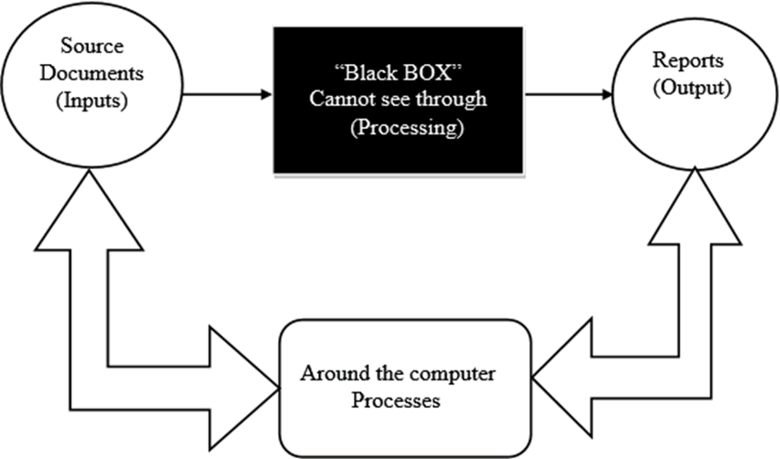
The comparison of inputs and outputs may be done manually with the assistance of the computer.
In simple words evidence is drawn and conclusions are reached without considering how inputs are being processed to provide outputs.

Slide 6
Black Box Approach continued
Most often the black box approach is used either because:
processing done by the computer is too simple e.g. casting, sorting etc
auditor is already aware of the software’s reliability. This is the case with most of off-the-shelf software used by client without any in-house alteration and thus need not to be checked.
auditor has no mean to gain understanding of the computer system and thus resorts with this approach. This situation can arise out of circumstances including:
  lack of appropriate system documentation
  auditor lacks expertise or skills to understand or use the computer system for auditing purposes.
  auditor is not given access to computer system at the level required

Slide 7
Audit around the computer is used in situations when auditor is of the opinion that computer system is reliable and often comparison of inputs to outputs is enough.
In other the auditor will not assess whether required controls are in place and if they are working operating effectively while inputs are processed.
However,, relying too much on this approach is not recommended for important aspects of the audit especially where assessed risk is high as this may result in ineffective audit and ultimately inappropriate audit opinion being expressed by the auditor.
As mentioned earlier that auditor will bypass computer system and will not check for existence and/or operating effectiveness of controls in processing data.

Slide 8
Auditing through the computer
In this approach the processes and controls surrounding the application are also subject to audit
-In order to help the auditor to gain access to these processes computer audit software may be used.
The technique is referred to as computer assisted audit technique (CAATS).
-It is obvious that to follow this approach the auditor needs to have sufficient knowledge of computer plans, direct supervise and review the work performed.
-The areas covered in the audit will concentrate on the following controls: Input control; processing control; storage control; output control; and data transition controls

Slide 9
Auditing through the computer continued
When auditing through the computer auditors follow the audit trail through the internal computer operations in order to verify that the processing controls are functioning properly
Additionally, it attempts to validate the accounting data being processed. The auditor assumes that the CPU and additional hardware are functioning properly.
As the computer processing is paperless and not visible by human eyes the auditors use Computer Assisted Auditing Techniques (CAATs) in auditing through the computer

Slide 10
Computer Assisted Auditing Techniques
CAATs use a computer to assist the auditor in testing during the audit procedures. There are 2 categories of CAATs:
Test Data and 2.
Audit Software
.

Slide 11
Advantages of CAATs to the Auditor
Test programmed controls: in a computer based accounting system, there are large volume of transactions which the auditor will have to audit.
The auditor will have to check if the programmed controls are functioning correctly. The only effective way of testing programmed controls is through CAAT.
Test on large volume of data: CAAT enable auditors to test large amount of data quickly and accurately and therefore increase the confidence they have in their opinion.
Test on source location of data: CAAT enables auditors to test the accounting systems and its records (e.g. disk files) at its source location rather than testing the printouts of what they believe to be a copy of those records.

Slide 12
Advantages of CAATs to the Auditor Continued
Cost effective: once set up CAAT are likely to be cost effective way of obtaining audit evidence year after year provided that the client does not change the accounting system regularly.
Comparison: allows results from using CAAT to be compared to traditional testing. Where the two results agree this increase the overall audit confidence.

Slide 13
Disadvantages of using CAATS
CAATs can be expensive and time consuming to set up, the software must either be purchased or designed (in which case specialist IT staff will be needed);
Client permission and cooperation may be difficult to obtain;
Potential incompatibility with the client's computer system;
The audit team may not have sufficient IT skills and knowledge to create the complex data extracts and programming required;
The audit team may not have the knowledge or training needed to understand the results of the CAATs; and
Data may be corrupted or lost during the application of CAATs.

Slide 14
Test Data
One of the Two Types of CAATs is Test Data
Test data involves the auditor submitting “dummy” data into the client’s computer system to ensure that the system correctly processes it and that it prevents or detects and corrects misstatements.
The objective of this is to test the operations of application controls within the system

Slide 15
Test Data Continued
To be successful test data should include data with errors built into it and data without errors. Examples include:
Codes that do not exist, e.g., customers, suppliers and employees
Transactions above predetermined limits, e.g., salaries above contracted amounts, credits above limits agreed with customers
Invoices with arithmetical errors and
Submitting data with incorrect control totals
Data may be processed during a normal operational cycle (live test data) or during a special run at a point in time outside the normal operational cycle (dead test).
Both have their advantages and disadvantages

Slide 16
Live data could interfere with the normal operations of the system or corrupt master file or standing data.
The auditor prepares input containing both valid and invalid data.
Prior to processing the test data, the input is manually processed to determine what the output should look like.
The auditor then compares the computer-processed output with the manually processed results
Note that, Test data involves the auditor submitting 'dummy' data into the client's system to ensure that the system correctly processes it and that it prevents or detects and corrects misstatements.

Slide 17
Test Data Summary
1. Contents of the Test Data
-Test data involves auditor preparation of a set of fictitious (dummy) data:
-The set of fictitious data is divided into two categories. One category consists of valid (correct) data and the other category invalid (incorrect) data.
-.For example, a customer sales order record contains the following data: Quantity 10, sales price 20 shillings, for a valid data, the total value of the sale should be calculated to 200
-But if the calculated value is 2000 then the application controls should detect the error because the data is invalid

Slide 18
Test Data Summary
2. How the Test Data is used by the auditor
-Prior to processing the test data, the input is manually processed to determine what the output should look like.
-The auditor then enters the test data through the client’s application programs.
-If the input data is entered into the system, the auditor will expect an input rejection. Conversely, the valid data should be processed without problems
- Results of input procedures are compared with expected behavior of application in order to determine whether input controls are in place

Slide 19
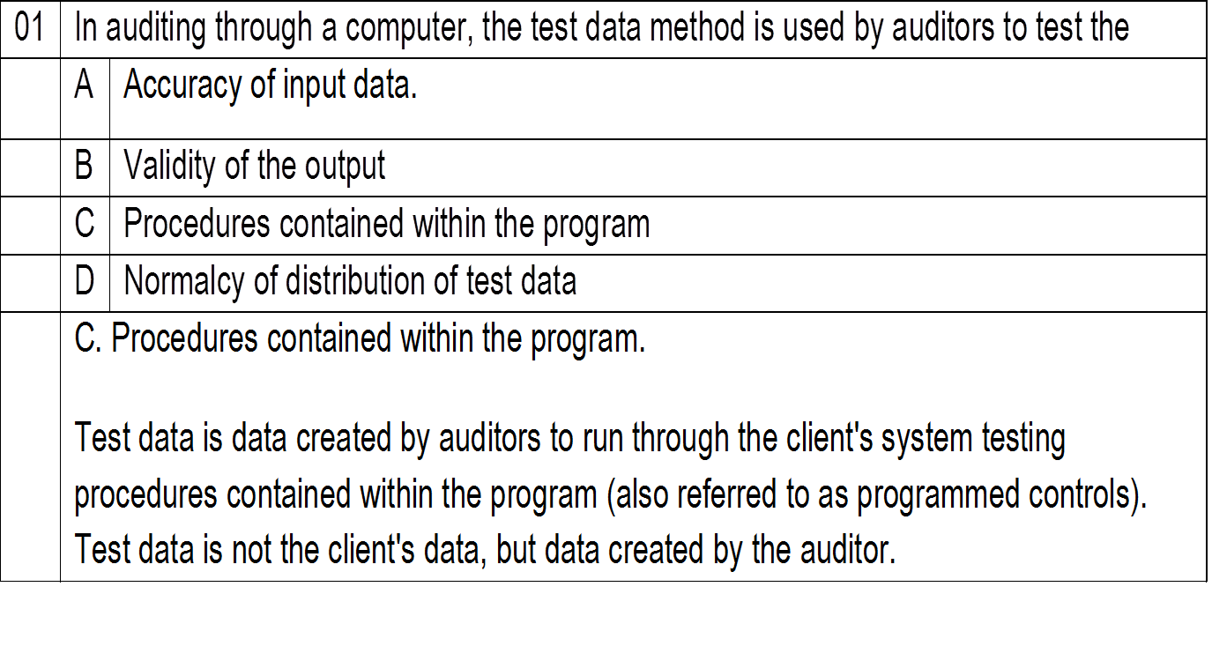

Slide 20
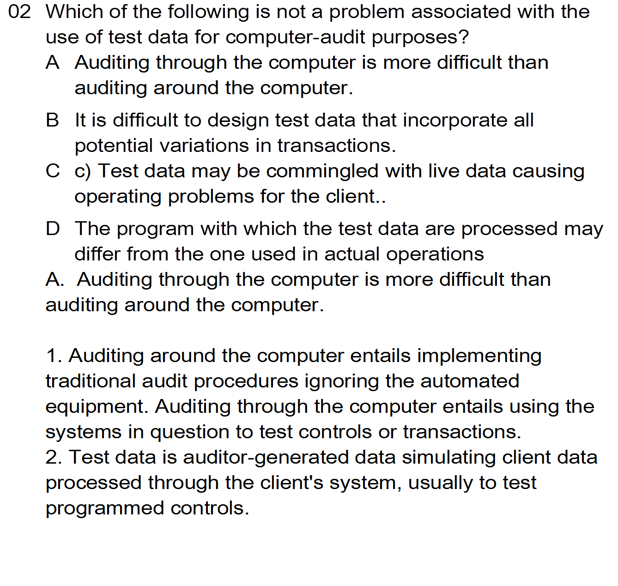

Slide 21
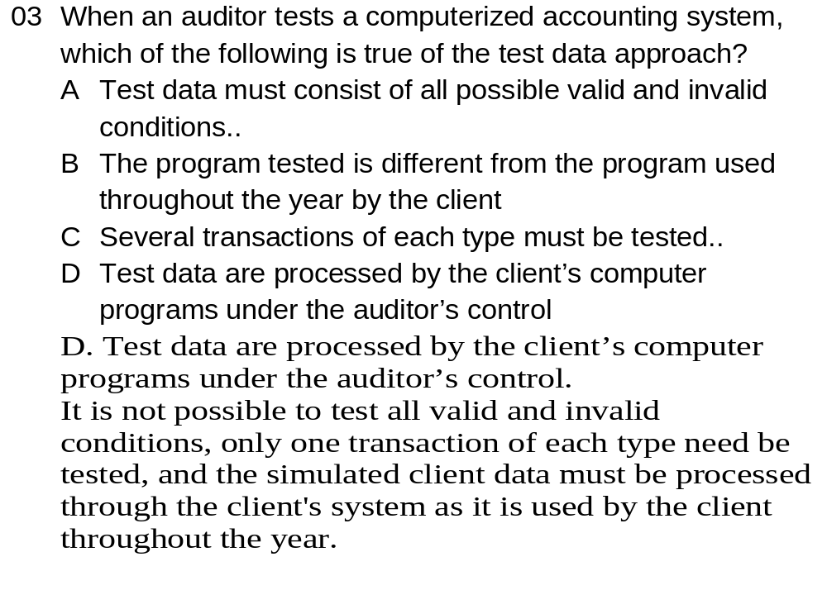

Slide 22
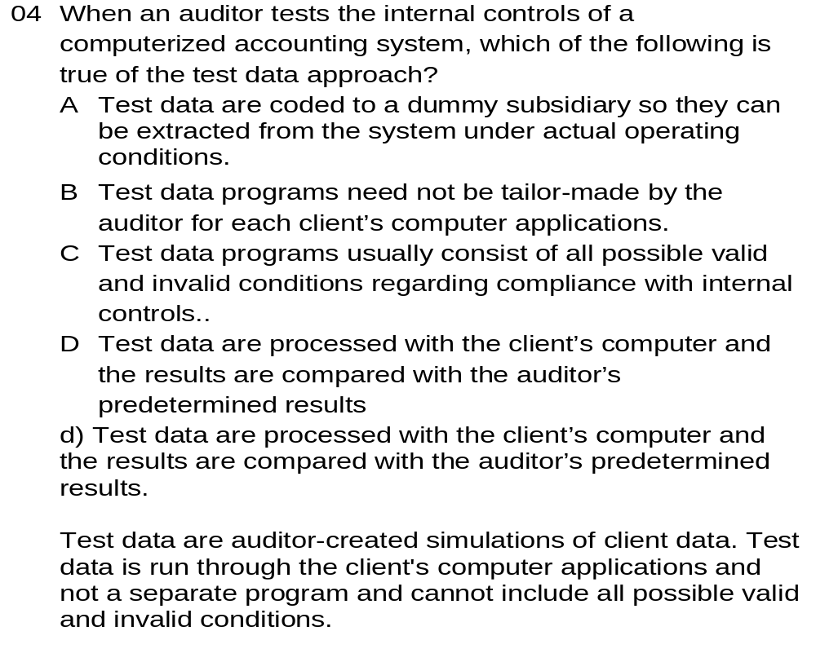

Slide 23
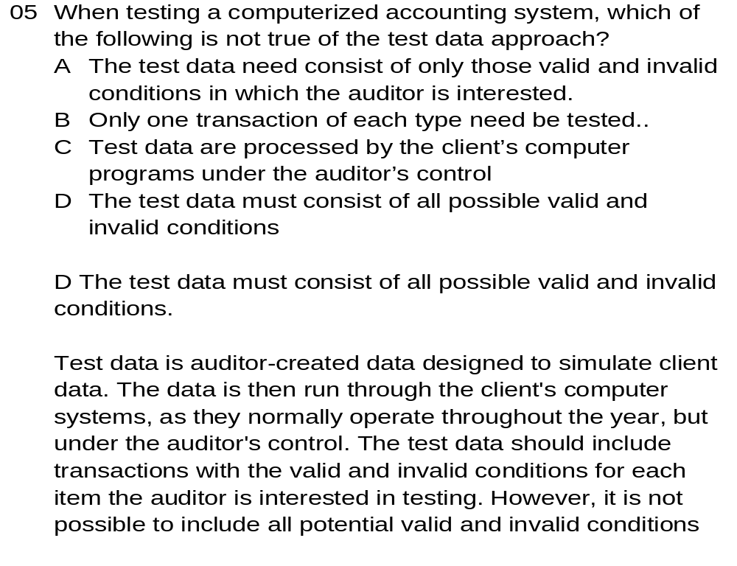

Slide 24
Audit Software
Audit software: comprises computer programs used for audit purposes to process data audit significance from the client accounting system.
It is used by the auditor to examine the entity:
computer files and may be used during both test of control and substantive testing of transactions and
balances as the program can scrutinize large volume of data and extract information,

Slide 25
Types of audit programs are:
Generalized packaged programs: however they need to be tailored to each specific case by defining the format of the files to be interrogated by specifying the parameters required and the form of that output.
Purpose written programs: these are specially written programs where it is not possible to adapt a package program because of the type of machine, processing or file organization used.
Utility programs used by the client: used by the entity to perform data processing functions such as sorting and printing of files e.g. excel.

Slide 26
The uses of audit software are:
Calculation checks: e.g. program gives the total amount of individual entries in purchases day book in a particular period. Auditor then agree this total amount to the amount posted in purchases ledger control a/c.
Detecting system violation rule: e.g. program checks that no customer has balance above specified credit limit.
Detecting unreasonable items: programs checks that no customer has discount of 50% or debtors balance is more than the amount of sales made to that customer.
New calculation and analysis: e.g. statistical analysis of inventory movements to identify slow moving items.
Selecting items for audit testing: e.g. obtaining a stratified sample of sales ledger balances
Completeness checks: e.g. checking continuity of sales invoices to ensure that they are all accounted for.

Slide 27
difficulties in using audit software
Set up cost is high: set up cost is high as initially client procedures need to be investigated and understood thoroughly prior to the audit software can be used to access and interrogate those files.
Changes are costly: if there are changes to client system, this will require costly alterations to the audit software.
Not suitable for small installations: there may be no suitable audit software for use on mini or micro computer installations.
Client accounting system documentation may be incomplete so that it is difficult to identify all procedures.
The cost of writing specific audit software to test those systems may be difficult to justify against the possible benefit on the audit or possibility of recovering the cost of the software.

Slide 28
briefly explain the difficulties of using audit software.
Set up cost is high: set up cost is high as initially client procedures need to be investigated and understood prior to the audit software
Changes are costly: if there are changes to client system,
Not suitable for small installations: there may be no suitable audit software for use on mini or micro computer installations.
Over elaboration: tendency to produce over elaborate enquiry programs which are expensive to develop, time consuming in processing and reviewing. Hence audit cost goes up and its difficult to justify its use.
Quantities of output: it may arise that output is too large either due to poor design of the software
Live database: the audit program need to be run on the live database (i.e. actual files) of the client because the auditor is testing the actual system of the client.

Slide 29
EXAM QUESTION
Orange Juice Company (Orange Co.) is a manufacturer of Orange juice in Tanga, The company operates from a large production facility, where it undertakes continuous production 24 hours a day, seven days a week. At this production facility there are two warehouses, where the company’s finished goods and raw materials are stored. Orange Co.’s finished goods consist of Orange juice packed in boxes, and the raw materials consists orange fruits, sugar, and flavours. Orange Co.’s year end is 31 December.
Orange Co. is finalising the arrangements for the year-end inventory count, which is to be undertaken on 31 December 2020. The finished Orange juice is stored within 20 lanes of the first warehouse. The second warehouse is for the raw materials. The following arrangements have been made for the inventory count: The warehouse manager will supervise the count as he is most familiar with the inventory.
There will be ten teams of counters and each team will comprise two members of staff. None of the warehouse staff, other than the manager, will be involved in the count. The level of work-in-progress in the manufacturing plant is to be assessed by the warehouse manager. It is likely that this will be an immaterial balance.

Slide 30
You are the audit manager of Gift & Najma audit firm, and your audit partner wishes to utilise Computer-Assisted Audit Techniques (CAATs) for the first time for controls and substantive testing in auditing Orange Co.’s inventory.
Required
While you understand that, computer assisted audit techniques (CAATs) are the methods of using a computer to assist the auditor in the performance of the computer audit:
Briefly explain any five (5) potential advantages of using CAATs in an audit (5 Marks)
Briefly explain any five (5) potential challenges of using CAATs in an audit (5 Marks)
Briefly explain the two approaches to EDP audit: The black box approach and the white box approach (6 Marks)

Slide 31
SOLUTION FOUR
(i) Advantages of using CAATS
– CAATs enable the audit team to test a large volume of inventory data accurately and quickly.
– If CAATs are utilised on the audit of Gift & Najma audit firm , then as long as they do not change their inventory systems, they can be cost effective after set-up.
– CAATs can test program controls within the inventory system as well as general IT controls, such as passwords.
– Allows the team to test the actual inventory system and records rather than printouts from the system which could be incorrect.
– CAATs reduce the level of human error in testing and hence provide a better quality of audit evidence.
– CAATs results can be compared with traditional audit testing; if these two sources agree, then overall audit confidence will increase.
– The use of CAATs can free up audit team members to focus on judgemental and high risk areas, rather than number crunching.

Slide 32
(ii) Challenges/Disadvantages of using CAATS
– The cost of using CAATs in this first year will be high as there will be significant set-up costs, it will also be a time-consuming process which increases costs.
– As this is the first time that CAATs will be used on Gift & Najma audit firm’s audit, then the team may require training on the specific CAATs to be utilised.
– Gift & Najma audit firm inventory system is likely to change in the foreseeable future, then costly revisions may be required to the designed CAATs.
– The inventory system may not be compatible with the audit firm’s CAATs, in which case bespoke CAATs may be required, which will increase the audit costs.
– If testing is performed over the live inventory system, then there is a risk that the data could be corrupted or lost.
– If testing is performed using copy files rather than live data, then there is the risk that these files are not genuine copies of the actual files.
– In order to perform CAATs, there must be adequate systems documentation. otherwise it will be difficult to devise CAATs due to a lack of understanding of the inventory system.

Slide 33
(b) The two approaches to IT Audit
1: A black box approach i.e., Auditing around the computer, or
2: A white box approach i.e., Auditing through the computer
1: The Black Box (around the computer) Approach
-In the black box approach the computer, the auditor concentrates on the inputs and outputs and ignores how data or transactions are processed by the computer.
-If input matches the outputs, the auditor assumes that the processing of data and transactions must have been correct and therefore the application controls are effective

Slide 34
Most Often this Approach is Used (Suitable) either because:
Processing done by the computer is too simple e.g., sorting, simple calculations etc
The auditor believes that the software used by the client is reliable. This is the case with most of off-the-shelf software used by client without any in-house change.
Auditor has no means of gaining understanding of the computer system and therefore, resorts to this approach. This situation may result from a number of reasons including: lack of appropriate system documentation; auditor lacks expertise or skills use the computer system for auditing purposes; auditor is not given access to computer system at the level required

Slide 35
2: The White Box (through the computer) Approach
In this approach the processes and controls surrounding the application are also subject to audit
In order to help the auditor to gain access to these processes computer audit software may be used. The technique is referred to as computer assisted audit technique (CAATS).
It is obvious that to follow this approach the auditor needs to have sufficient knowledge of computer plans, direct supervise and review the work performed.
The audit will focus on all application controls including storage control; and data transition control
The auditor would also need to satisfy himself / herself that there are adequate general controls, such as, the prevention of unauthorized access to the computer and the computer database

